Slide 1
Photo ABCD User Manual
A-Alligators team
Cassie, Ryan, Sam, Logan, & Justin

Slide 2
What is Photo ABCD?
A social media application that allows users to post blogs with photos, videos, titles, and descriptions of topics they would like to share with other users.
The site offers a responsive design where both public and personal blogs can be sorted and displayed in alphabetical or chronological order.
The application also allows users to create custom "Alphabet Books" from their created blogs to be printed and saved as a physical copy or shared with others beyond the online application.
User's can register for a personalized account using an email, name, and secure password.
User's can login to their created account and update their blogs, settings, and alphabet books.

Slide 3
Site Map

Slide 4
What are the Main Pages of Photo ABCD?

Slide 5
Public Site View
When a user is not logged in, the default view for the site is the public view.
The public view contains two pages:
Home Page
About Us Page

Slide 6
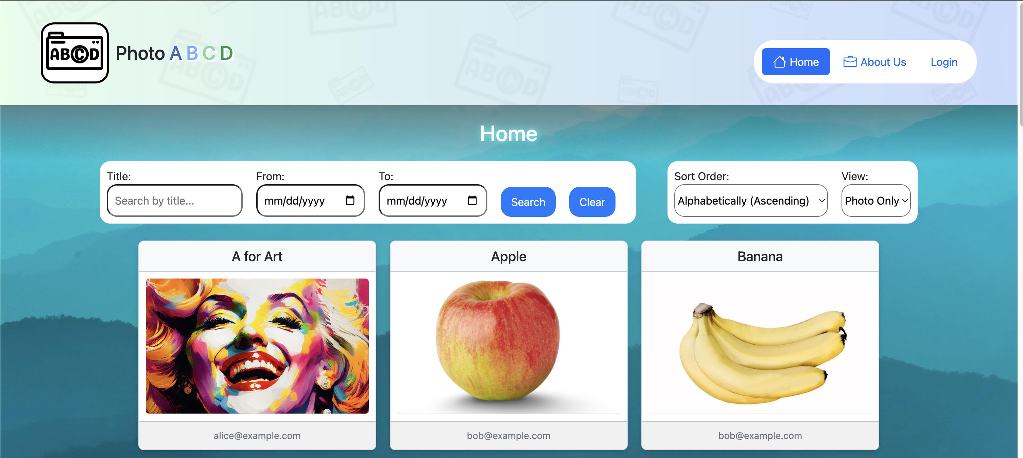
Home Page
The home page houses multiple blog posts alongside search and sort functionality.
Visitors can scroll through all posted blogs that have been marked as "Public" by the creator.
Additionally, visitors ​can choose between "Traditional" and "Photo Only" views, allowing them to enjoy blogs in the way that best fits their preferences.

Slide 7
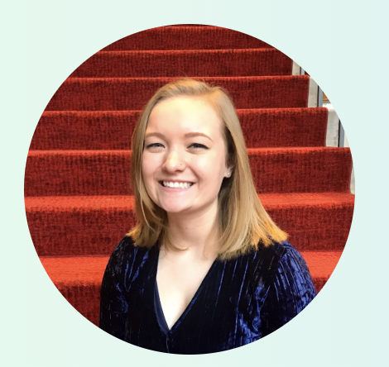
About Us Page
The about us page contains an introduction to the creators of the website and is available to all visitors.
Provides Team Insights
Allows all visitors to get to know the diverse skills and unique perspective that each team member brings to the table.
Gives all visitors a change to get to know the individuals behind the project.

Slide 8
User Site View
When a user registers or logs into their account, the view is updated to include several additional site pages
The logged in user view contains five pages:
Home Page (can be viewed in public view)
My Blogs Page
Alphabet Book Page
About Us Page (can be viewed in public view)
Settings Page

Slide 9
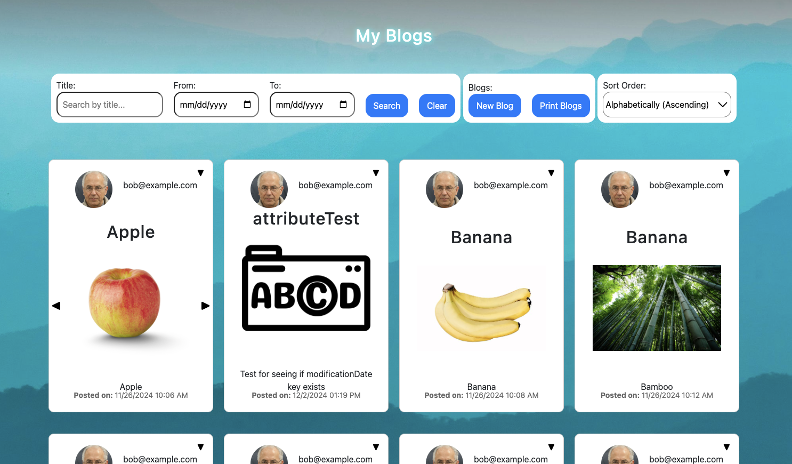
My Blogs Page
This page displays all the blogs created by a logged in user.
Through this page, a user can create a new blog to display privately or publicly.
Blogs can be sorted alphabetically, chronologically, or found by blog title.
When the downward arrow on a blog is selected, three options appear:
Print
Edit
Delete

Slide 10
Alphabet Book Page
Maintains a collection of "Alphabet Books" from the user which can be saved, deleted, updated, and printed. These books are contained in the "Book Bar" and will display all the blogs associated for that book.
The page displays a grid of cards for all 26 letters of the alphabet. On click, these cards then displays a selection menu which the user can choose any number of blog entries available for that letter.
Upon receiving a change, either to the book title or any of its entries, the "Save Book" button is enabled, and the user is allowed to save the book.

Slide 11
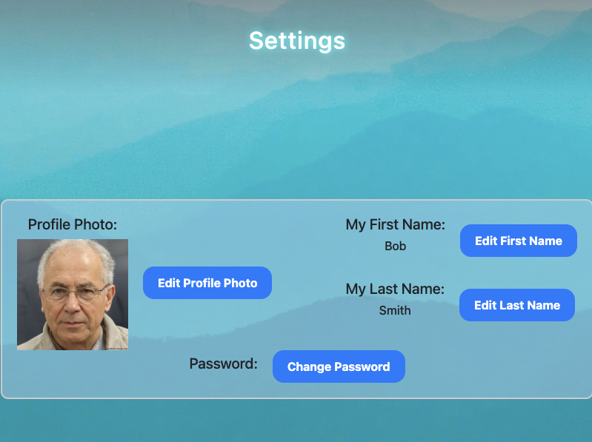
Settings Page
This page is where a user can make changes to their blogging profile.
They may update their profile photo, first name, and last name.
Their profile photo will display on their created blogs.
In addition, they may edit their account password.

Slide 12
Admin View – Administration Page
When a user's account is assigned admin permissions, that user has access to one additional page called the "Administration Page."
The Admin Page contains several data tables:
Users Table – Contains a list of all users of the application.
Blogs Table – Contains a list of all blogs in the application.
Alphabet Book Counts Table – Contains a list of users and their completed and incomplete alphabet book counts.
Site Totals Table – Contains the total number of blog entries and the total number of users.
Administratio

Slide 13
Additional Site View/Navigation Tools

Slide 14
Navigation Bar
Located at the top of the site, it allows user to navigate to different pages of the website.
The bar will automatically update if whether user is logged into their account. It will also update if the user's account is assigned admin permissions.
Nav Bar Public View
Nav Bar User View
Nav Bar Admin User View

Slide 15
Sort Bar Options
Both the Home and My Blogs Pages contain sort bars with several options to view the public and private blogs.
Users can enter titles, select date ranges, sort the blogs in the order they would prefer.

Slide 16
User Registration and Login

Slide 17
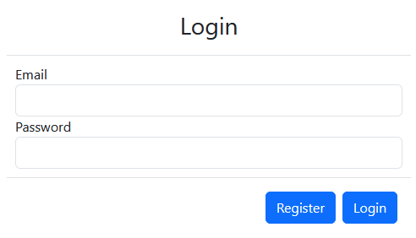
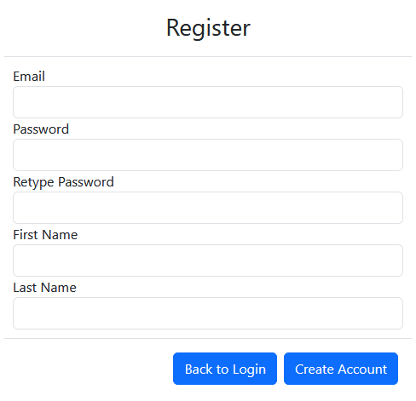
Login/Registration
Login and registration are both handled by two separate modals.
The modal is displayed upon clicking the Login button in the Navigation.
The user can then either log in, or switch to the registration modal.

Slide 18
Home Page Visitor View

Slide 19
Home Page Visitor View
When viewing the home page, users are greeted with a blog photo and various options for viewing and sorting.
Users can also choose to view the photos only by selecting the photo only option.
Upon clicking a blog post, users will get a more detailed view of the blog, such as who posted the blog while in photo only view.

Slide 20
Alphabetical and Chronological Blog Compilation – Home Page

Slide 21
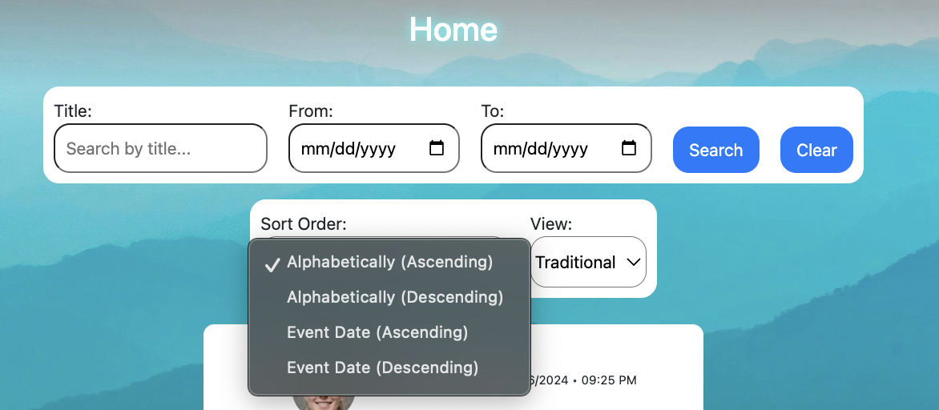
Blog Sorting Display
Users can choose to view the blogs by changing how they are sorted, choosing from alphabetically sorted in ascending or descending order.
As well as chronologically via sorting by event date in either ascending or descending.

Slide 22
Search and Filter Options – Home Page

Slide 23
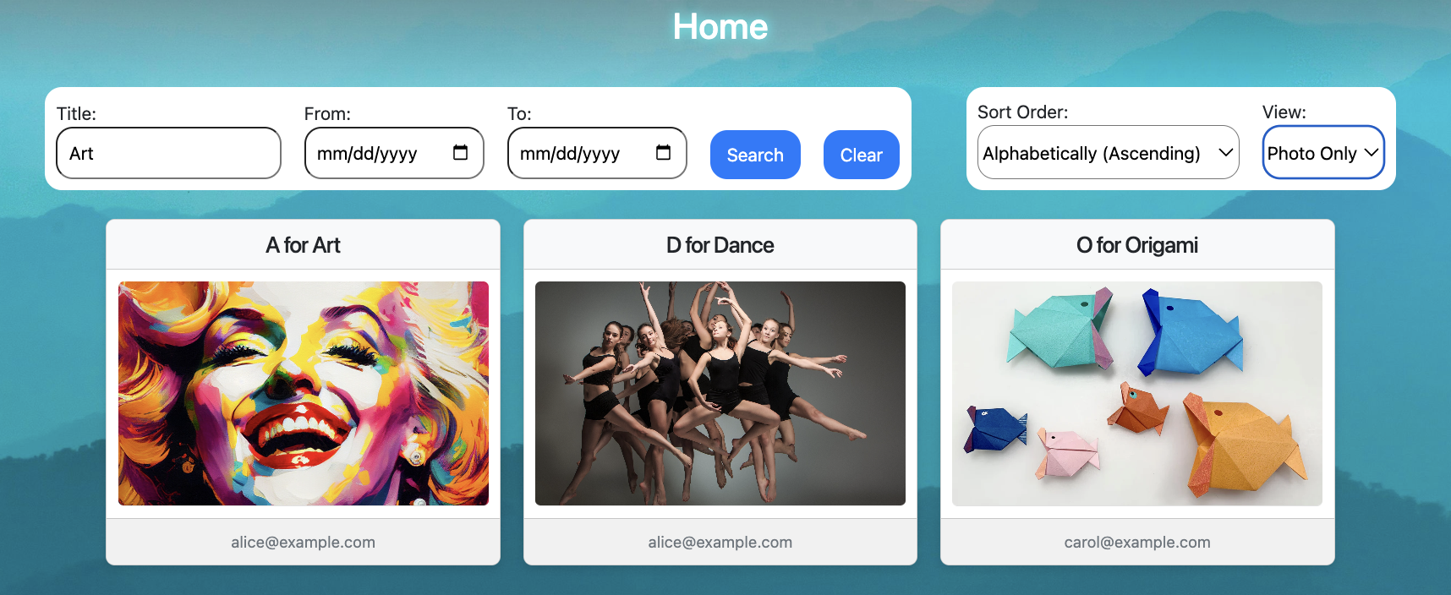
Search and Filter Options
Users can search for a specific blog post by its title or blog description.
They can also filter with the dates the blogs were created.

Slide 24
My Blogs Page For Logged-in Users

Slide 25
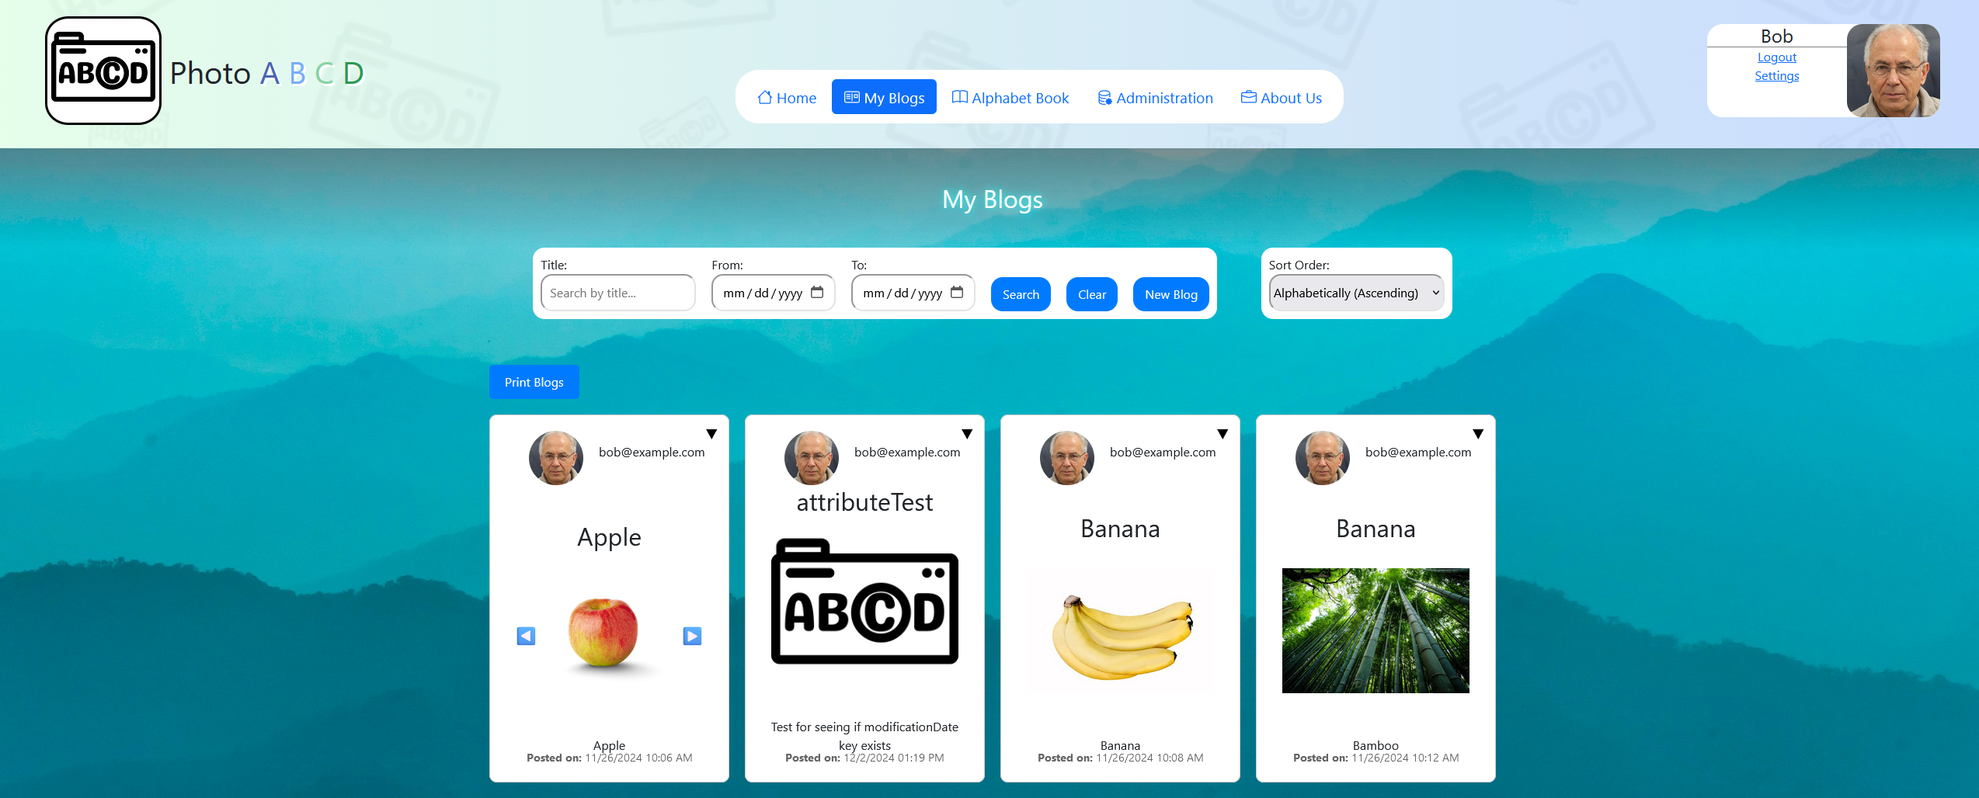
View for logged in users
Upon successful login, users are given access to the My-Blogs page.
This gives users access to all blogs that they have created. Users have options to search, sort, print, edit, and delete their blogs.

Slide 26
Blog Post Creation

Slide 27
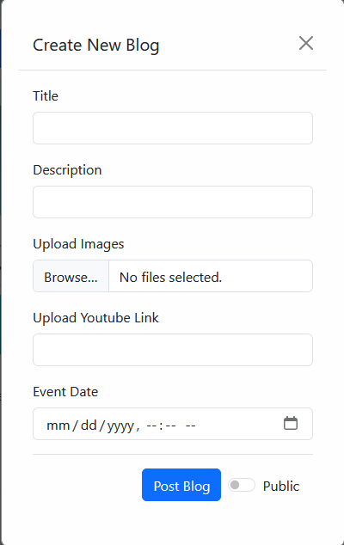
To create a blog post from the my-blogs page, users can click the new blog button.
This will open the following pop-up, prompting users for information for their new blog:
Users can set an initial title, description, and event date, as well as determine the ability for the blog to be shared publicly or remain private. If a user changes their mind, they may edit the blog post can.
Users can upload images, gifs, YouTube video links, or a combination of all three.
If a user wishes to exit before creating the blog post, they may click outside of the pop-up or click the 'x' in the upper right corner.
Once a user has satisfactorily entered their data, it will be validated providing user feedback if an issues arose. If the data was positively validated the blog post will be created.

Slide 28
Blog Post Editing/Deletion

Slide 29
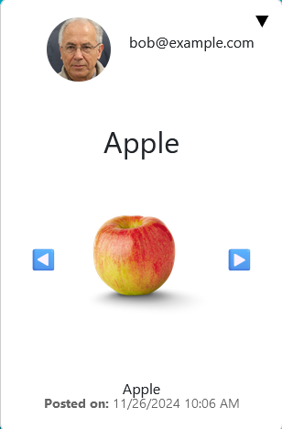
Users are able to edit/delete individual blogs. They can do so by clicking the caret in the upper right corner of the blog they wish to change or delete to option an options menu.
Selecting the delete button will prompt the user with a popup asking "Are you sure you want to delete this blog post?"
Once the user selects 'OK' the blog post will be deleted.
If the user does not intend to delete the post, they must click cancel

Slide 30
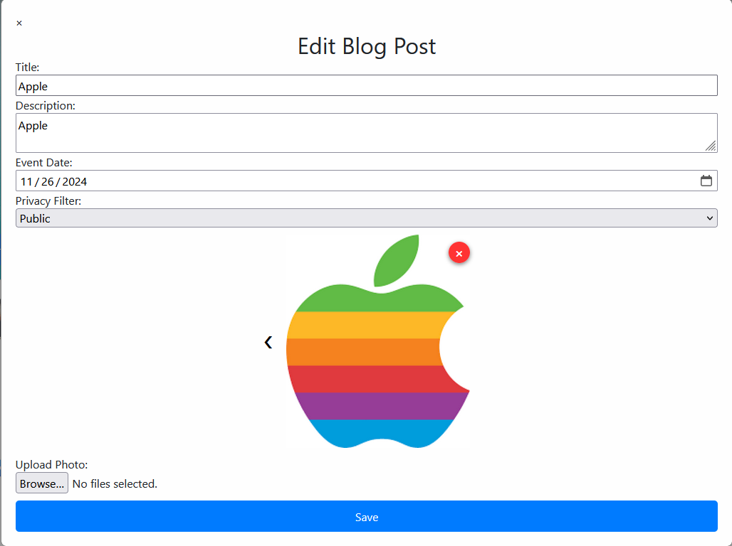
If the user selects edit, the following popup will open, providing the user the options to edit title, description, event date, as well as delete selected photos from the blog post or add additional photos. Additionally, users can edit any YouTube links attached to the post.
Users can view multiple photos within a blog post by clicking the arrows to the side of an image. If no arrows are present, there are no additional photos to display.
To delete a selected image, simply click the red 'x' in the upper right corner of the image. The user will be prompted asking "Are you sure you want to delete this photo?" The user can click 'Ok' to delete the image or click cancel.

Slide 31
Sharing and Collaboration – My Blogs/Home Page

Slide 32
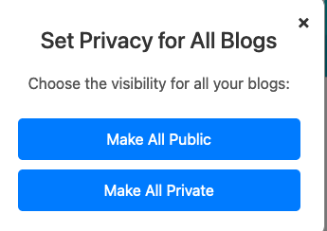
Users can make all their blogs public or private, regardless of their current privacy setting.
To do so, users can click the Privacy button
After users click the privacy button, a pop-up will prompt the user to change the privacy settings for ALL their blogs.
Once a user has made a selection and clicks the desired outcome, they will be prompted with a reminder that the action cannot be undone after they hit 'OK.'
Hitting 'OK' will make the desired changes while hitting cancel will bring them back to the original privacy pop-up.
To exit the pop-up without making a change to privacy settings, simply hit the 'x' in the upper right-hand corner.

Slide 33
Alphabetical and Chronological Blog Compilation – My Blogs

Slide 34
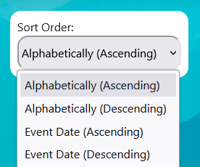
Users can selectively sort their My Blogs page as they see fit.
They can sort their blogs alphabetically or chronologically based on event date.
To do so, users simply click the Sort Order text bubble near the search bar to change the option.
Clicking the sort order text bubble provides the following options:
Clicking the desired option will reload the page providing the user their blogs sorted based on their selection

Slide 35
Search and Filter Options – My Blogs

Slide 36
Users are able to search through their blogs in the My Blogs page.
They can search via Title or key word. The search will include mentions in the description for the title users search for. To search for the desired title or keyword, users can hit enter or click search.
Users are also able to search via event date range. By selecting the desired date range and hitting the search button, users will be shown any blogs that match the desired date range.

Slide 37
Download or Print Feature – My Blogs

Slide 38
Users have the option to download/print their blog collection chronologically.
By clicking the Print Blogs button under the search bar, users can generate a printable PDF containing their blogs listed chronologically, which includes a table of contents.
Additionally, if users wish to print individual blogs, they may do so by clicking the caret in the upper right corner of the blog they wish to print and clicking the print option.

Slide 39
Alphabet Book

Slide 40
Alphabet Book - Primary Functionality
Create New Book
Delete Current Book
Edit Book Title
Save Current Book
Print Current Book Blogs

Slide 41
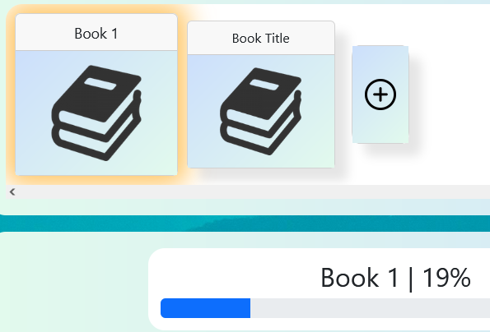
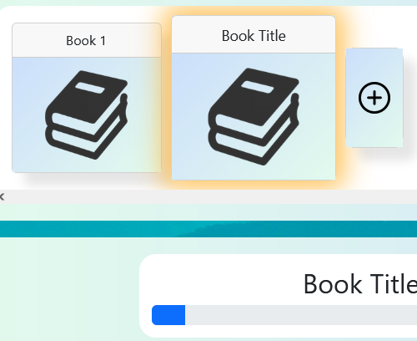
Book Selection Logic
The Alphabet Book page tracks which book is currently selected.
Selected books are selected either when clicked or on initialization.

Slide 42
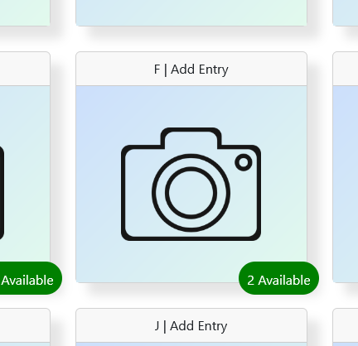
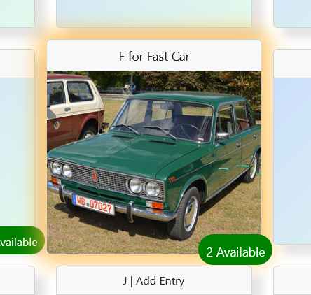
Blog (Grid) Selection Logic
Grid cards are selected on click and remain selected if a valid change is made.

Slide 43
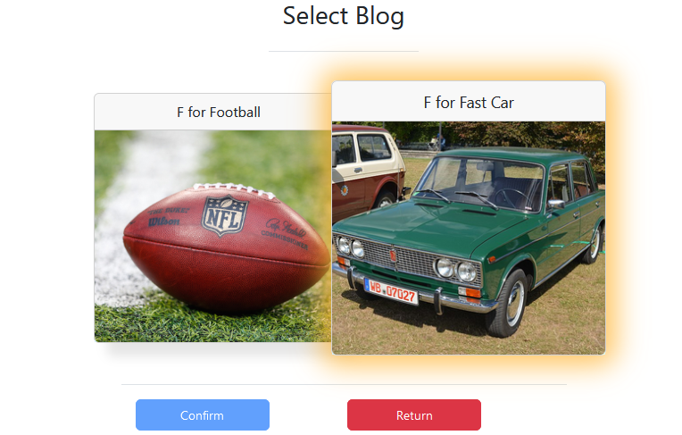
Blog (Modal) Selection Logic
On clicking on any card in the blog grid section, a modal is displayed which shows all the valid blogs for that letter.
Blogs that are already in that letter entry come pre-selected.
The user can toggle the selection by clicking any entry in the menu.

Slide 44
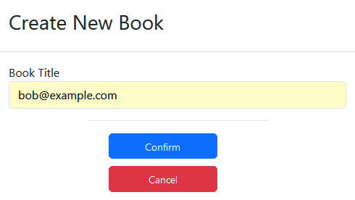
Create New Book
Users can create a new book by clicking on the + button in the book bar.
Upon click, the user will then be prompted to enter a title for the book.
The title must be between 1-16 characters, and must only use numbers, letters, and spaces.

Slide 45
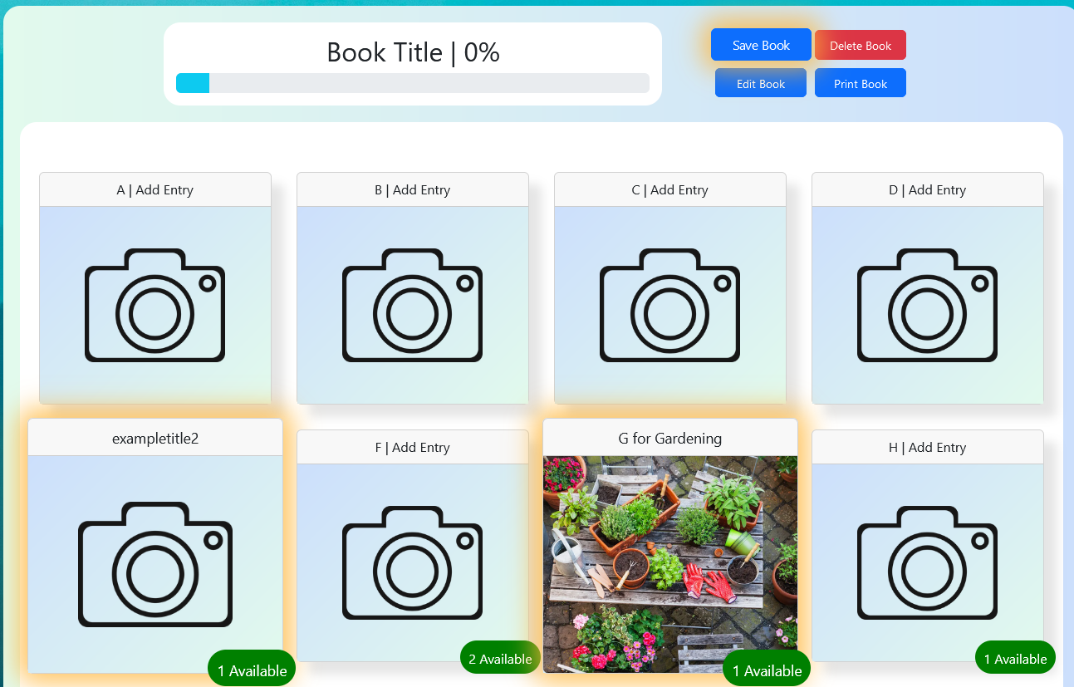
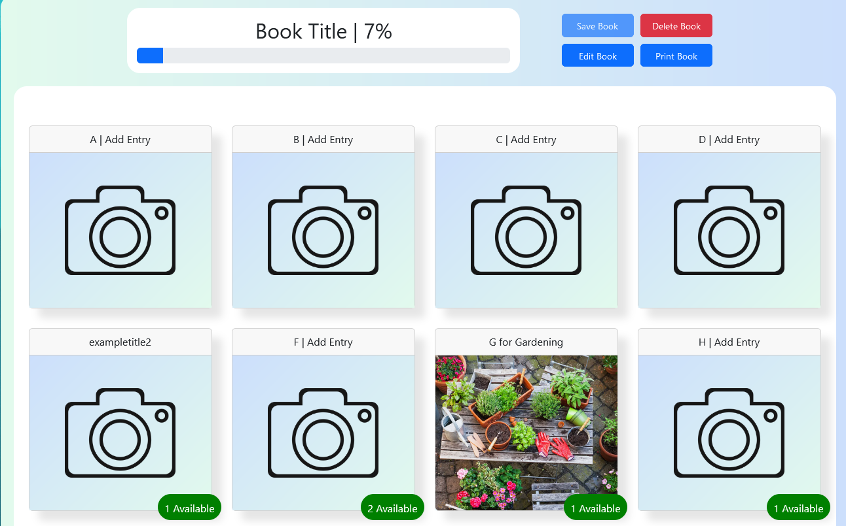
Save Current Book
Upon making a change to the book title, or any one of its letter entries, the save button is enabled, and highlighted. Clicking this button will save the current book.

Slide 46
Delete Current Book
The user can delete the current book by clicking the delete button twice.
Clicking once will highlight the button and enable a deletion condition for three seconds.
The button will revert to its initial state after book deletion or timeout.

Slide 47
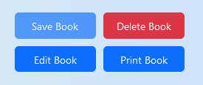
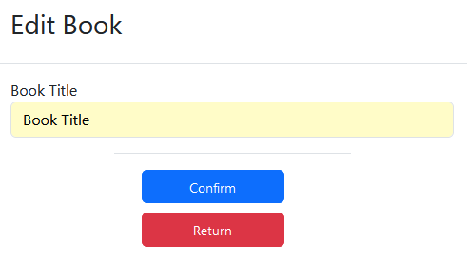
Edit Current Book
Clicking the "Edit Book" button displays a modal to edit the current book title.
Titles must be between 1-16 letters, numbers, or spaces. (No special characters/symbols)
Titles must not already be used by another book from the user.

Slide 48
Print Current Book
Upon clicking the "Print Book" button, the print menu is displayed.
Only blogs defined by the book are printed. Other possible blogs are ignored.

Slide 49
Admin User and Blog Management

Slide 50
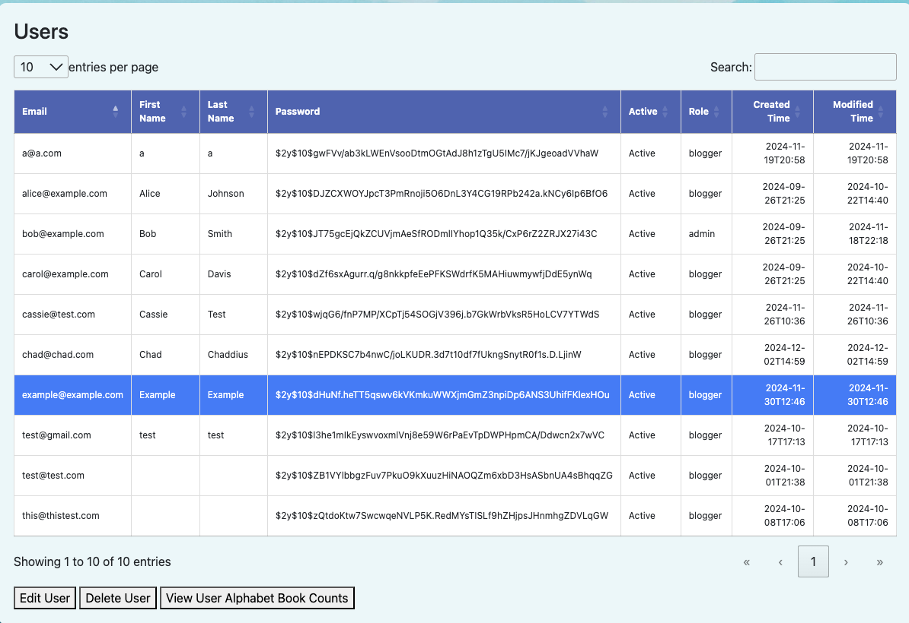
Admin Page Options - Users
The users table displays all the users of the application.
By selecting a user, an admin can perform several user updates:
Edit User
The user's information can be updated. The user's name, password, active status, and role may all be updated. If an admin user want to give another user admin permissions, this is where the admin role can be assigned.
Delete User
The delete user option allows and admin to delete any user and their associated blogs. Note when an admin is deleting a user, the admin may delete all the user's blogs but does not have to.
View Alphabet Book Counts
This option allows the admin to view the alphabet book counts of a specific user. The table shows which 26 letters are completed and which ones are not.

Slide 51
Admin Page Options - Blogs
The blogs table shows all the created blogs on the application.
By selecting a blog, an admin has the following options:
Edit Blog
An admin may update blog titles, blog descriptions, event/creation/modification dates, and whether the blog is private or public.
Delete Blog
An admin may delete any blog they find to be inappropriate.

Slide 52
Admin Dashboard

Slide 53
Admin Dashboard – Alphabet Book Counts & Site Totals
The Alphabet Book Counts table displays the completed and pending alphabet book counts of every user of the application.
The Site Totals table displays the total number of blog entries on the site as well as the number of users.

Slide 54
Demo – Try the Application!

Slide 55
Demo
Register User Account with new email, name, and password.
Go to settings and update user's profile photo.
Navigate to Home Page to view public blogs and sort and view options .
Traditional and Photo Only Views
In Home Page, click on user's email to view their created blogs.
Navigate to My Blogs Page, create a new public blog with multiple photos.
In My Blogs, try print blog option and edit option.
Navigate to Alphabet Book Page, create new Alphabet Book. Add newly created blog into the book and save.
Print newly created Alphabet Book.
----------------------------------------- Admin Demo Use Only -----------------------------------------
Login to admin account, navigate to Administration Page.
In Users table, edit the newly created account name and view their alphabet counts.
In Blogs table, edit the newly created blogs title and description and save.
Display Alphabet Book Counts and Site Totals tables.

